Slide 1
Explainable Time Series based on Feature Importance
Yuyuan Feng (冯昱源)
Msc, School of Software
Xiamen University
2024/5/11

Slide 2
Outline
Explainable AI in general
Feature importance for time series
Dynamask (ICML 2021)
TimeX (NeurIPS 2023 Spotlight)
Notes:
为什么用一个代理模型而不是直接输出解释？

Slide 3
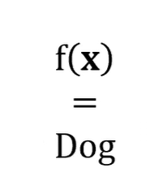
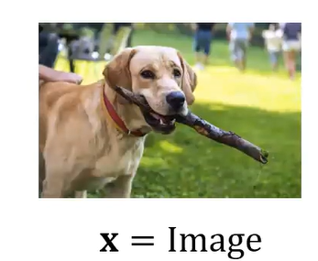
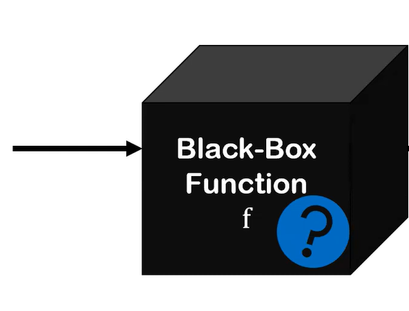
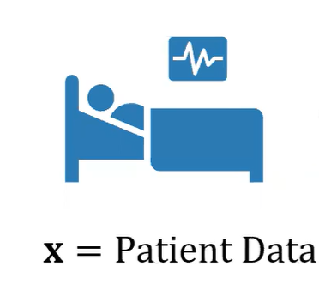
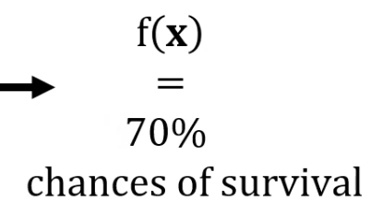
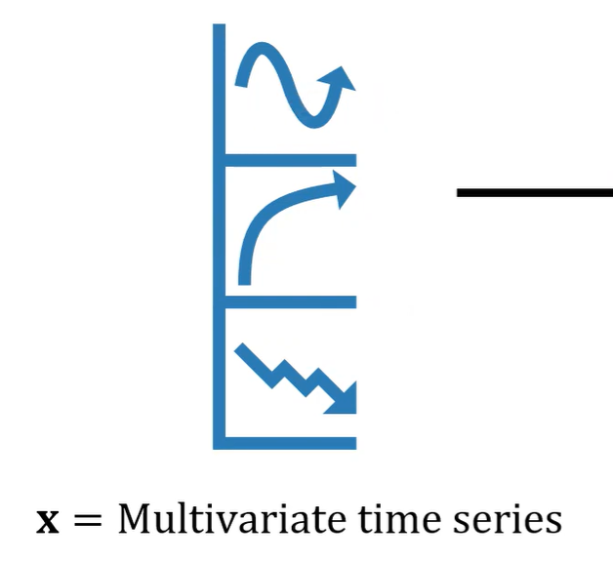
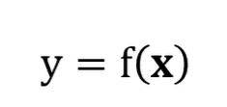
Explainable AI

Slide 4
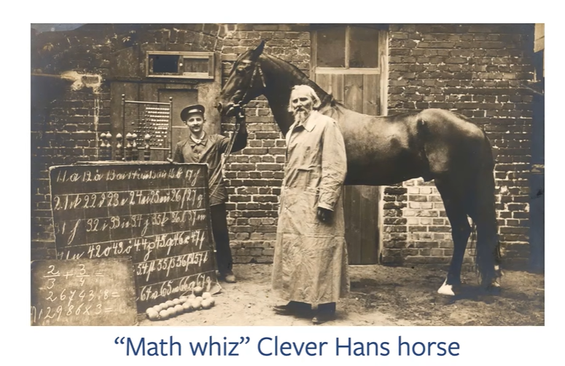
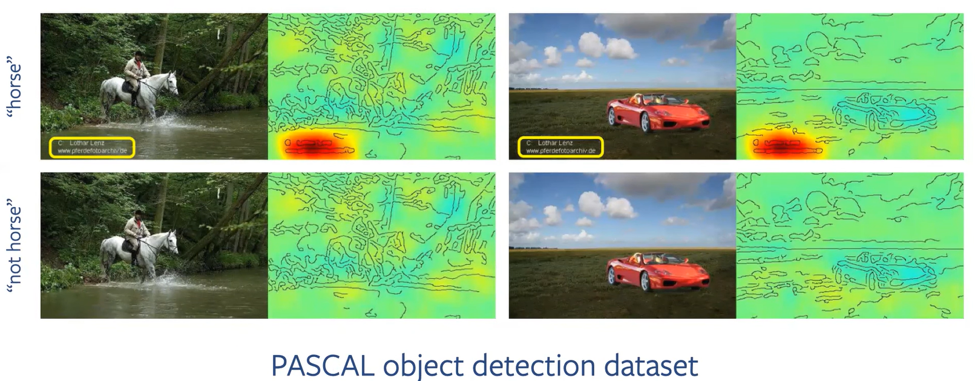
Explainable AI is important
ML models impact high-stakes domains (medicine, finance, transport…)
ML models can be wrong
In a scientific view, explanations are (at least) as important as predictions
Notes:
机器学习模型也会犯这样的错误，比如草地上的狗 vs 雪地上的狗

Slide 5
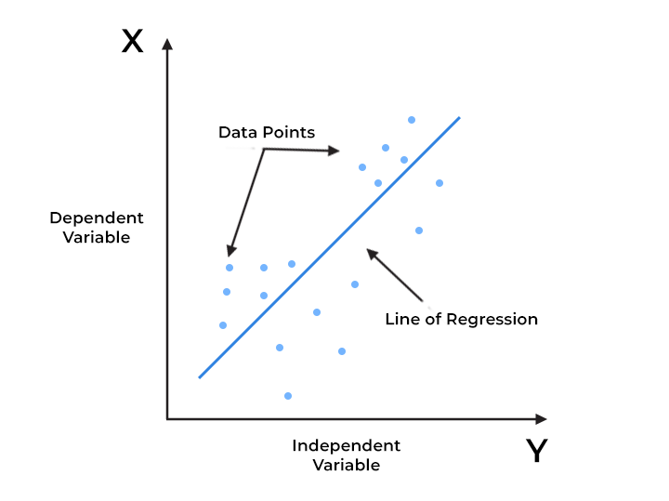
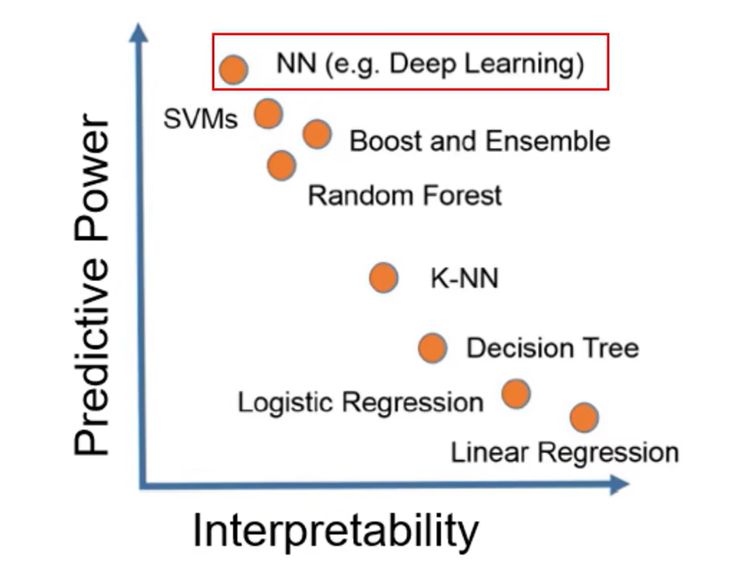
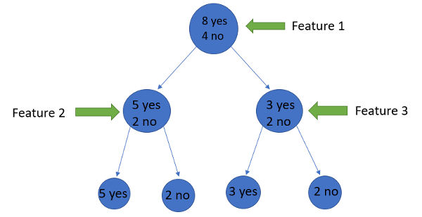
Explainable AI Categories
Inherently explainable ML models
Notes:
有一些模型天然具有较强可解释性
IG方法模型较大时具有计算复杂度

Slide 6

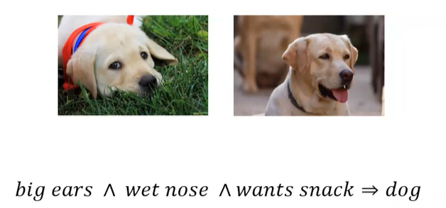
Explainable AI Categories
Post-hoc explanations
Feature importance explanations
Highlight the most important features for the ML prediction, ex: Integrated Gradient, Perturbation-based methods, SHAP
2. Example-based explanations
Reference to the relevant examples seen by the ML model
Rules-based explanations
Provide explicit formulae for ML’s predictions
Notes:
实际上，人们通常会觉得例子比单纯的特征重要性更有可解释性，举一个看病的例子。

Slide 7
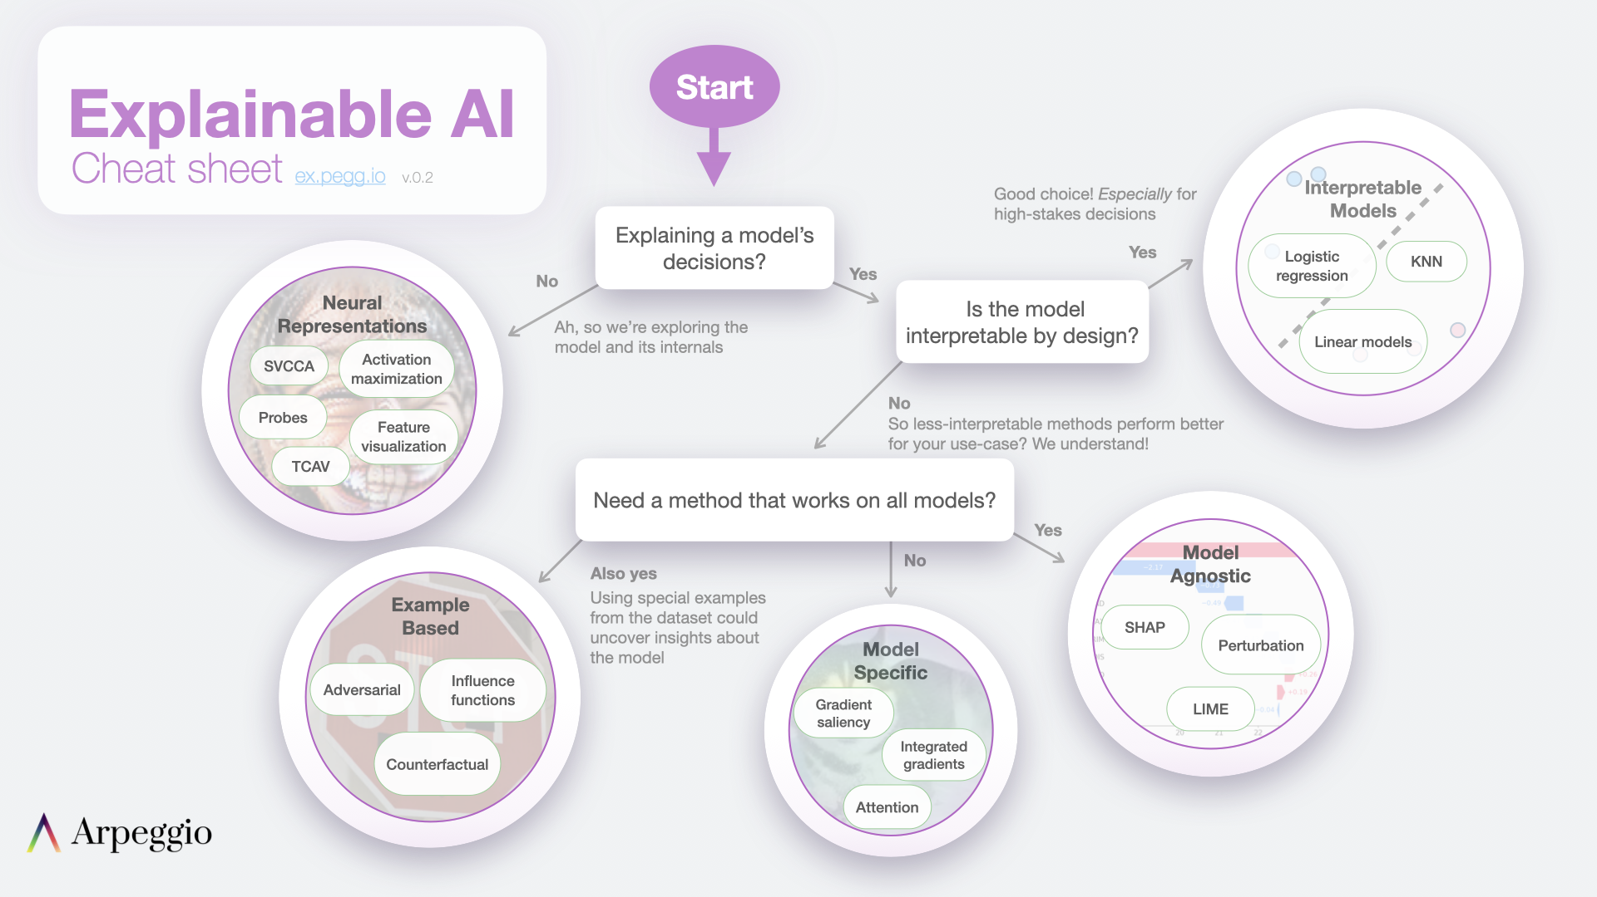

Slide 8
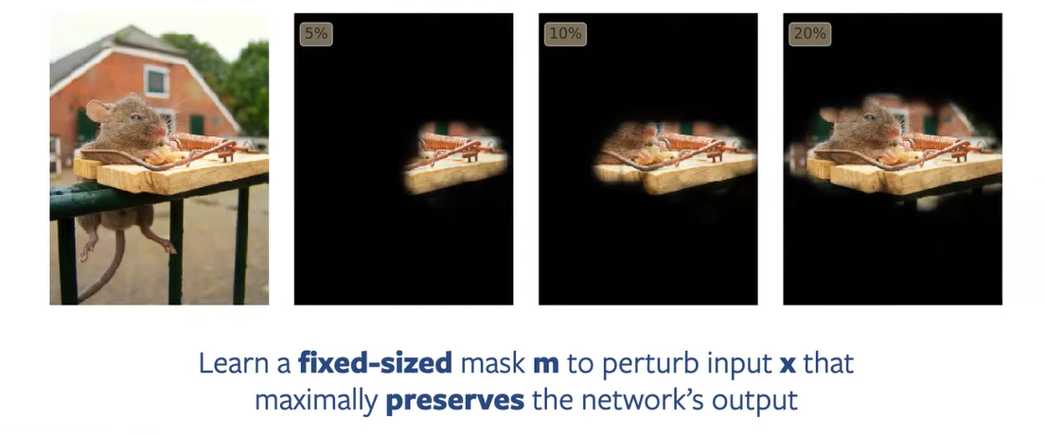
Feature Importance
Computer Vision Setting
Fong & Vedaldi, ICCV 2019
Notes:
我们想要生成一个这样的 Mask矩阵

Slide 9
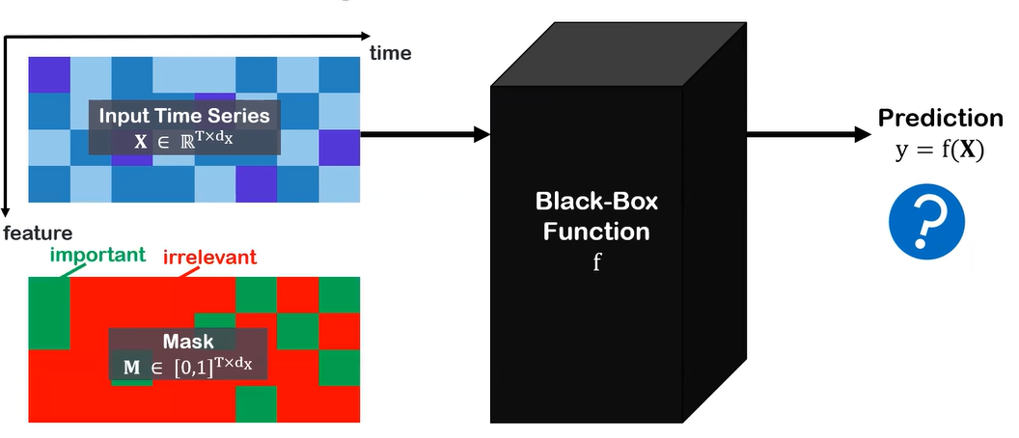
Feature Importance for time series
Time Series Setting
Notes:
我们想要生成一个这样的Mask矩阵

Slide 10
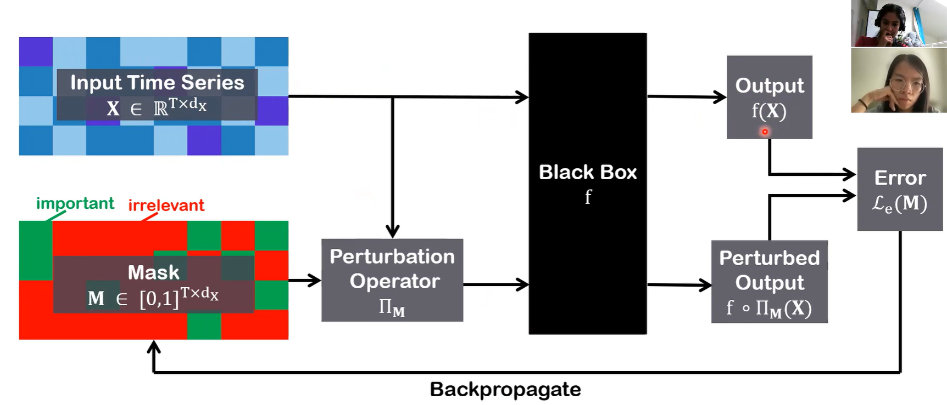
Feature Importance for time series
What happened here?
Can simply be set to 0/mean as in image?
Notes:
具体怎样学到这样的Mask呢？ Mask 尽可能多无关的信息
重点是Perturbation Operator?这里面发生了什么，使得：
M = 1的特征i, t不变
M=在0和1之间的特征被干扰

Slide 11
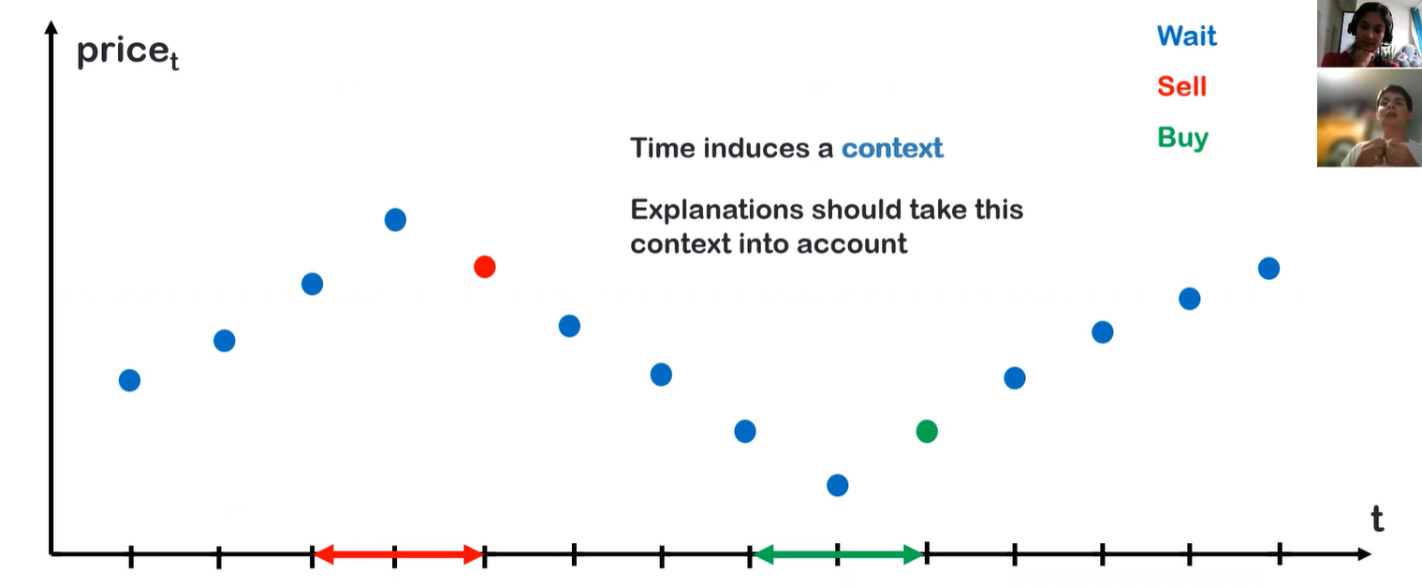
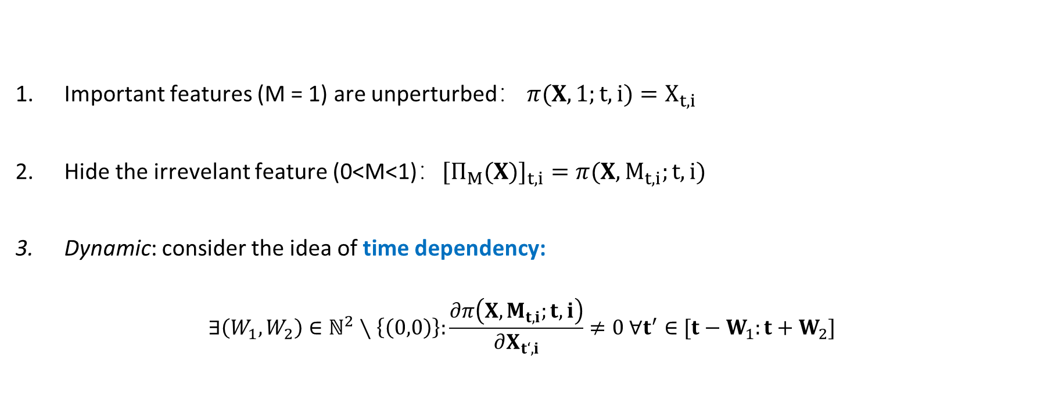
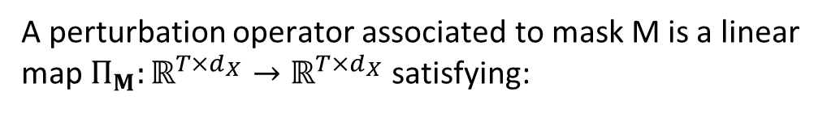
Dynamask
Dynamic Perturbation Operator
A perturbation operator associated to mask M is a linear map $Π_{M}:ℝ^{T×d_{X}}→ℝ^{T×d_{X}}$ satisfying:
Important features (M = 1) are unperturbed： $π(X,1;t,i)=X_{t,i}$
Hide the irrevelant feature (0<M<1)：$[Π_{M}(X)]_{t,i}=π(X,M_{t,i};t,i)$
Dynamic: consider the idea of time dependency:
$$∃\left(W_{1},W_{2}\right)∈ℕ^{2}∖\left\{\left(0,0\right)\right\}:\frac{∂π\left(X,M_{t,i};t,i\right)}{∂X_{t‘,i}}≠0 ∀t^{′}∈[t−W_{1}:t+W_{2}]$$
“窗口中所有时间步都受邻居时间步的影响”
Crabb ́ e and Schaar, Explaining Time Series Predictions with Dynamic Masks, Cambridge, ICML 2021

Slide 12
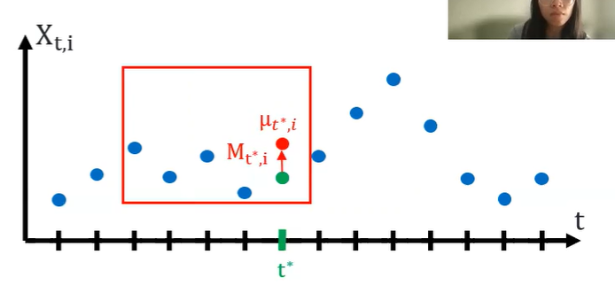
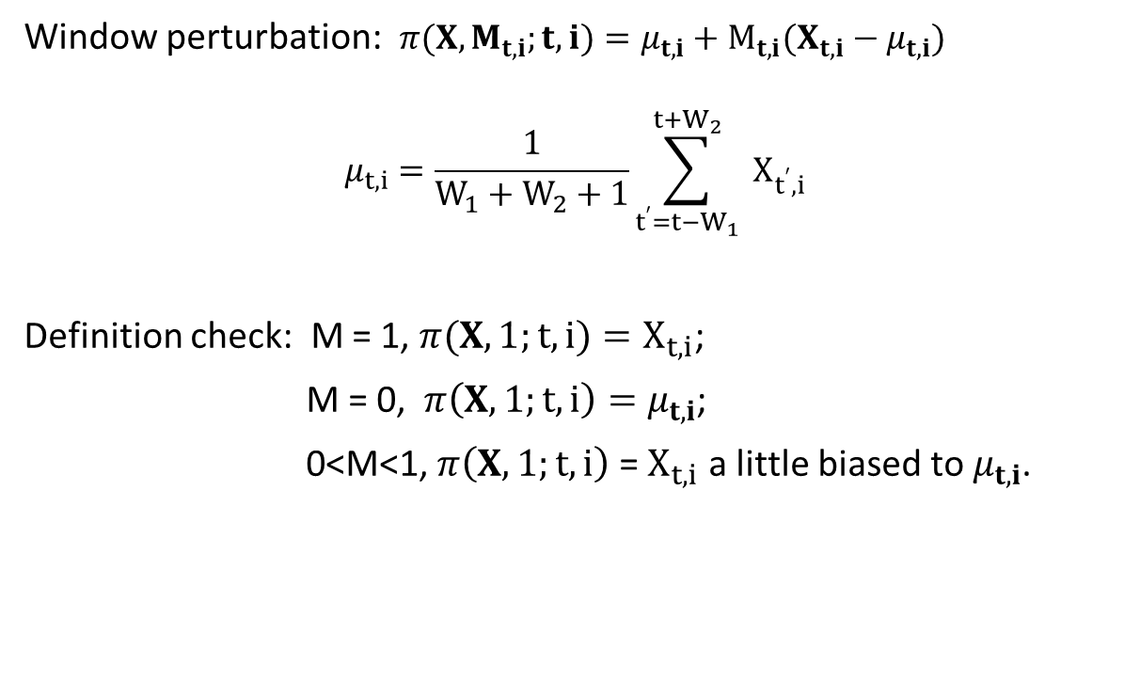
Dynamask
Dynamic Perturbation Operator
Window perturbation: $π(X,M_{t,i};t,i)=μ_{t,i}+M_{t,i}(X_{t,i}−μ_{t,i})$
$$μ_{t,i}=\frac{1}{W_{1}+W_{2}+1}\sum_{t^{′}=t−W_{1}}^{t+W_{2}}{ }X_{t^{′},i}$$
Definition check: M = 1, $π(X,1;t,i)=X_{t,i}$;
M = 0, $π\left(X,1;t,i\right)=μ_{t,i}$;
0<M<1, $π\left(X,1;t,i\right)$ = $X_{t,i}$ a little biased to $μ_{t,i}$.
Crabb ́ e and Schaar, Explaining Time Series Predictions with Dynamic Masks, Cambridge, ICML 2021

Slide 13
Dynamask
\
What happened here?
Crabb ́ e and Schaar, Explaining Time Series Predictions with Dynamic Masks, Cambridge, ICML 2021
Notes:
具体怎样学到这样的Mask呢？ Mask 尽可能多无关的信息
重点是Perturbation Operator?这里面发生了什么，使得：
M = 1的特征i, t不变
M=在0和1之间的特征被干扰

Slide 14
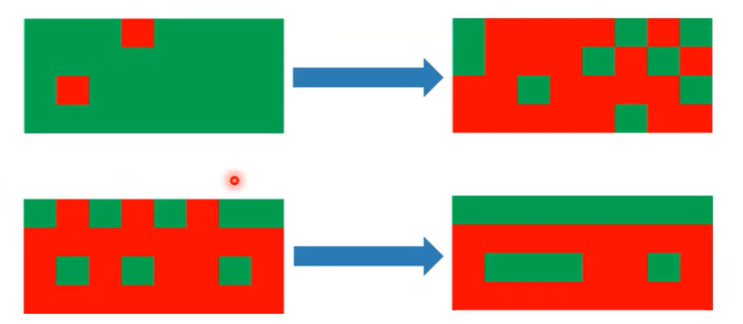
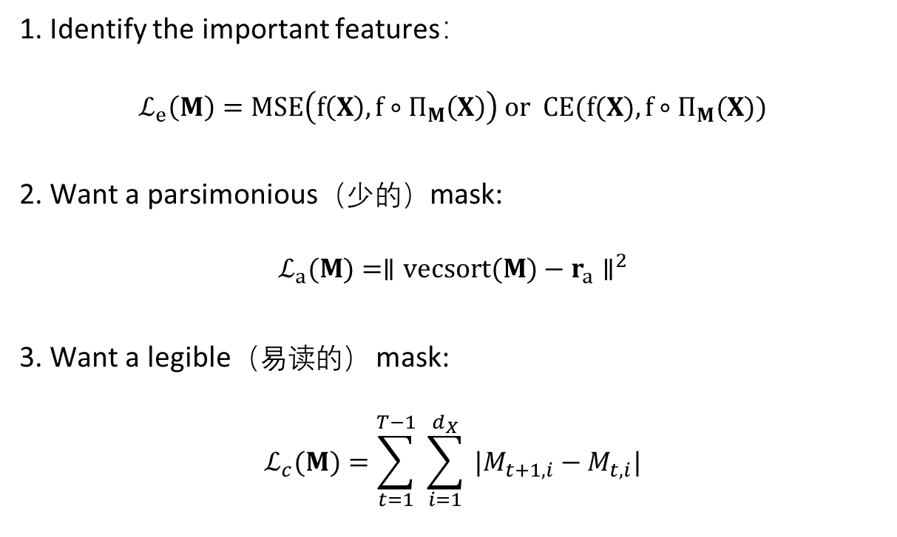
Details of Dynamask
Optimize the Mask
1. Identify the important features：
$$ℒ_{e}\left(M\right)=MSE\left(f\left(X\right),f∘Π_{M}\left(X\right)\right) or CE(f(X),f∘Π_{M}(X))$$
2. Want a parsimonious（少的）mask:
$$ℒ_{a}(M)=∥vecsort(M)−r_{a}∥^{2}$$
3. Want a legible（易读的） mask:
$$ℒ_{c}(M)=\sum_{t=1}^{T−1}{ }\sum_{i=1}^{d_{X}}{ }|M_{t+1,i}−M_{t,i}|$$
Crabb ́ e and Schaar, Explaining Time Series Predictions with Dynamic Masks, Cambridge, ICML 2021
Notes:
具体怎样学到这样的Mask呢？ Mask 尽可能多无关的信息

Slide 15
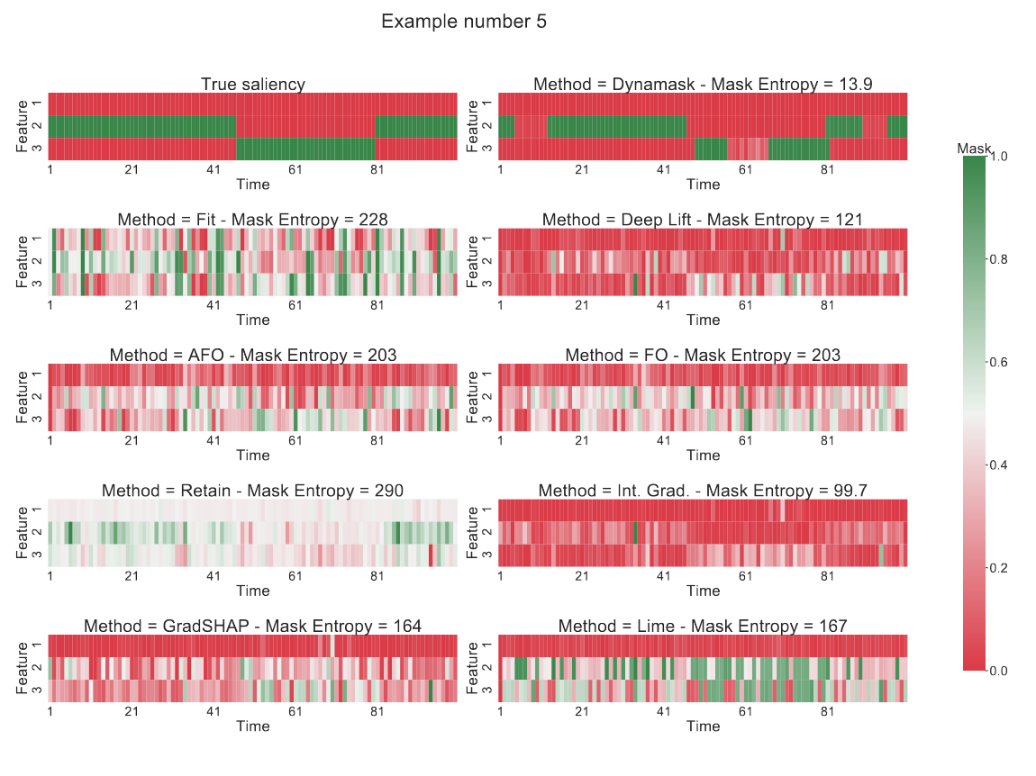
Results of Dynamask
Crabb ́ e and Schaar, Explaining Time Series Predictions with Dynamic Masks, Cambridge, ICML 2021

Slide 16
Summary of Dynamask
Strength
A very typical based on perturb-based feature importance
Take temporal context into consideration, incorporate temporal smoothing
Optimize the mask to be parsimonious and legible
Limits
Lack of looking deeper than only the model’s output (i.e. latent representations)
Perturbing the time series may generate out-of-distribution samples for the explained model, resulting in unfaithful explanations akin to adversarial perturbation
Notes:
[2]加文章解释

Slide 17
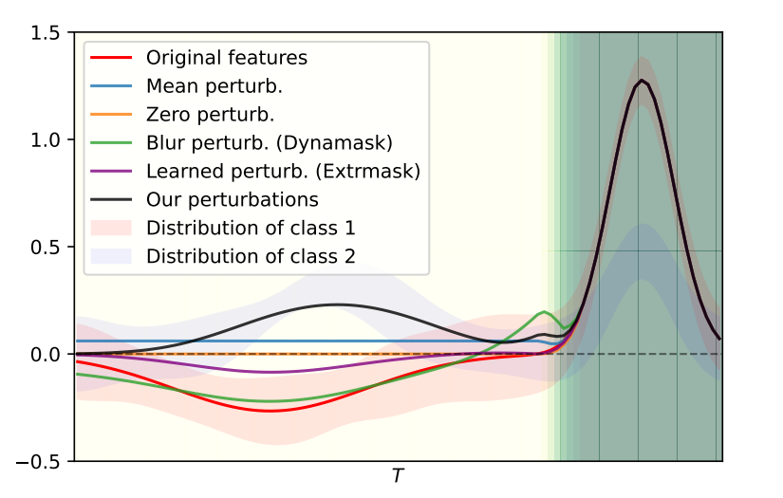
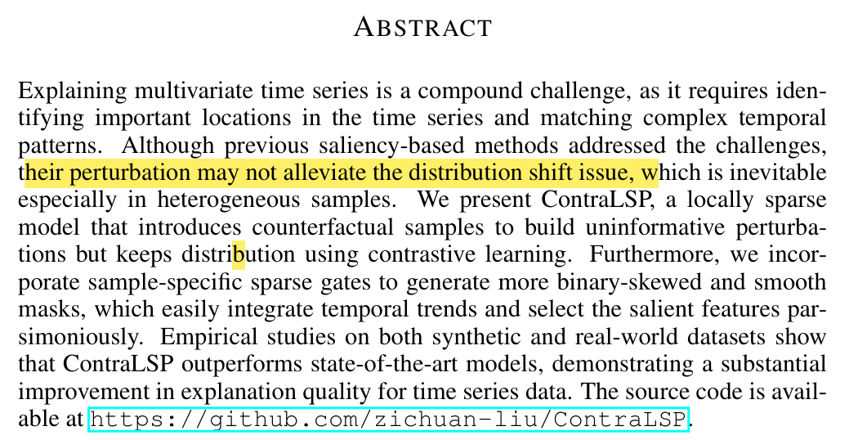
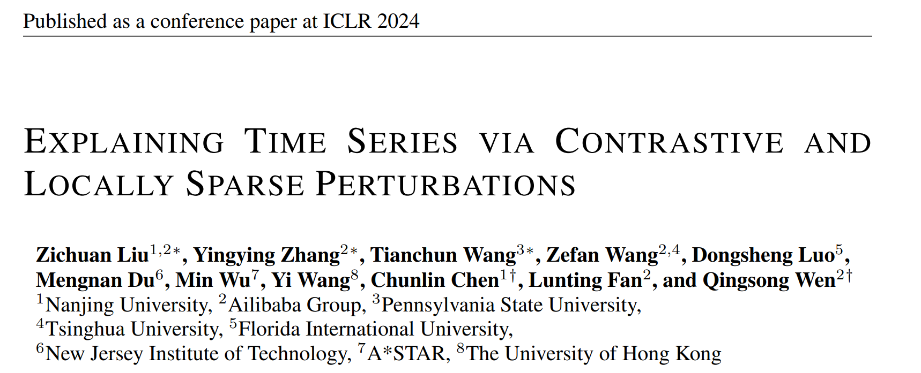
Summary of Dynamask
Perturbed time series may be out of distribution for the explained model

Slide 18
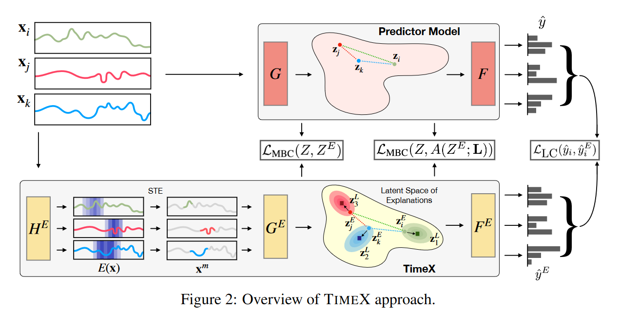
TimeX: an extension to perturb-based methods
Overview
Use a surrogate model to match the original (pre-trained) time series model through mimicking its latent space and predictions
TimeX provides discrete attribution masks, giving interpretable explanations for the model's predictions
Propose Model Behavior Consistency (MBC) to encourage the distances to be similar across both latent explanation space and output space, add the faithfulness of explanation
Queen et.al, Encoding Time-Series Explanations through Self-Supervised Model Behavior Consistency, Harvard, NeurIPS 2023 Spotlight
Notes:
是基于扰动方法mask原输入以找到不变特征的一个延申
创新在于重新训练一个代理模型, 而不是基于原模型做扰动，这样增加了模型的可信度。

Slide 19
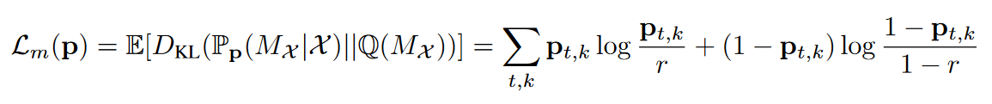
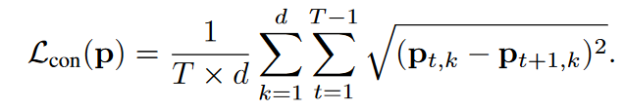
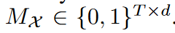
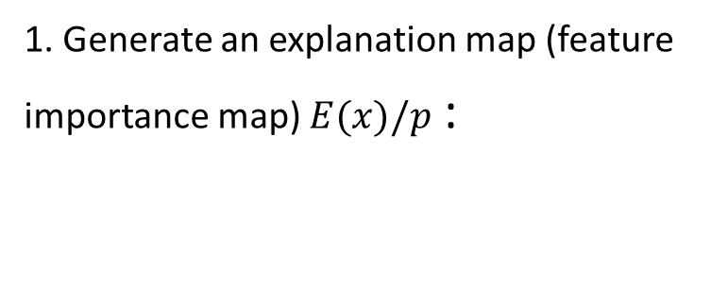
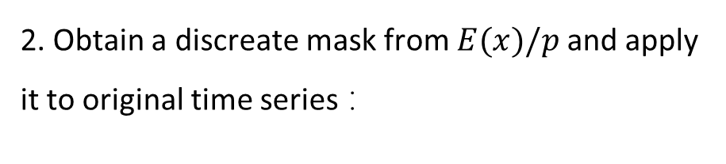
Details of TimeX
Generate discreate attribution masks
1. Generate an explanation map (feature importance map) $E(x)/p$ :
基于GAST的information bottleneck (IB) 思想
2. Obtain a discreate mask from $E(x)/p$ and apply it to original time series ：
基于straight-through estimator (STE), 即离散的mask
Notes:
什么是Mx? 经过mask后的E(x)
什么是landmark？聚合相似的explanations

Slide 20
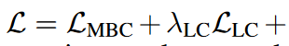
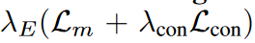
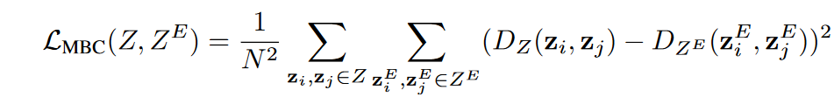
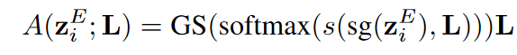
Details of TimeX
Model Behavior Consistency
Latent Representation Consistency:
Label Consistency: (Jensen-Shannon Divergence (DJS))
Landmark Consistency

Slide 21
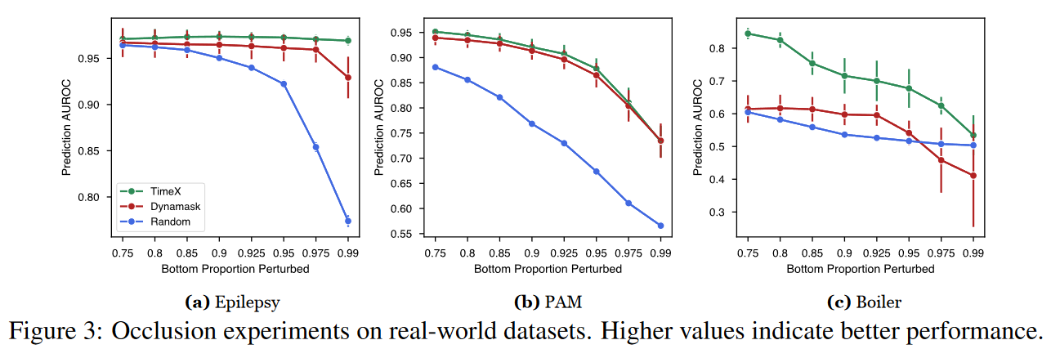
Results of TimeX
Both synthetic and real-world datasets

Slide 22
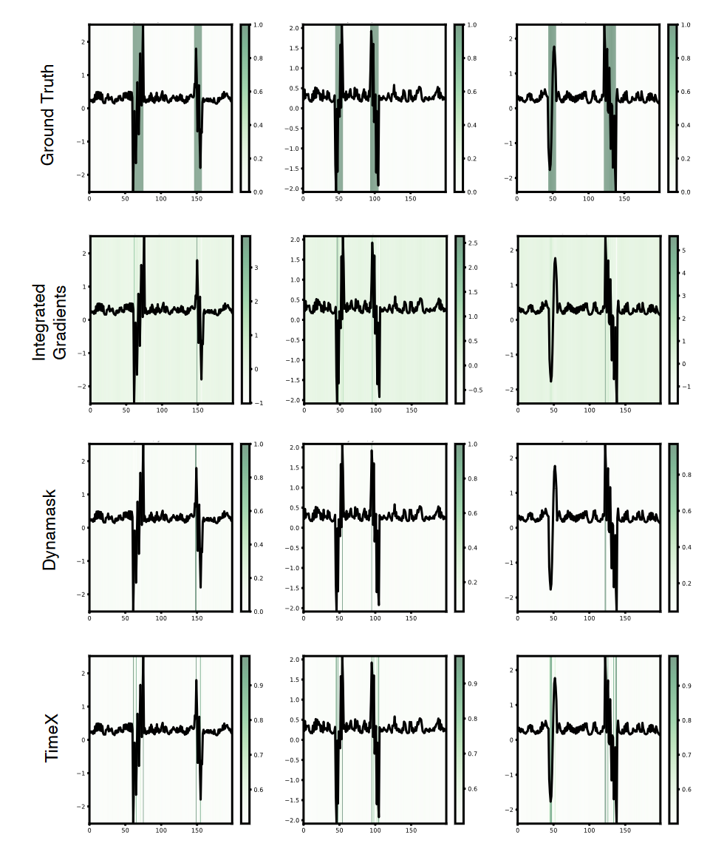
Results of TimeX

Slide 23
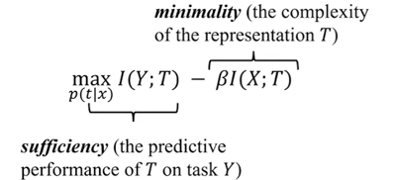
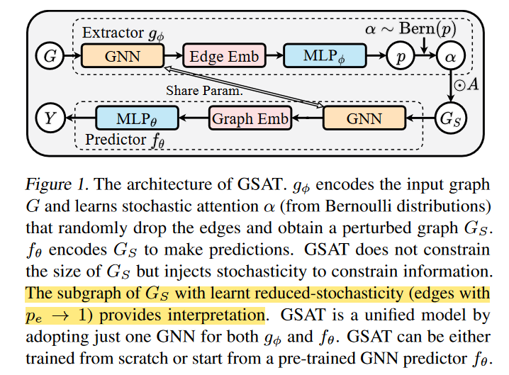
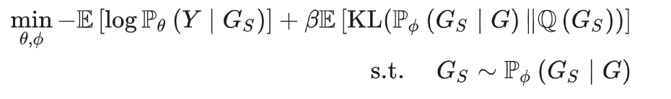
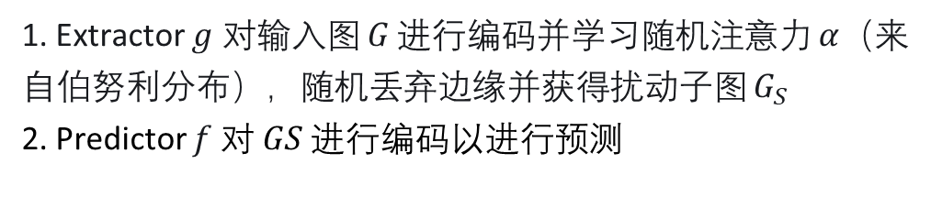
GAST: Interpretable and Generalizable GNN
受信息瓶颈IB理论推导启发，选取标签相关的子图：
从IB理论推导，随机减少label-invariant的特征，从而得到可解释、泛化性强的GNN模型
1. Extractor $g$ 对输入图 𝐺 进行编码并学习随机注意力 𝛼（来自伯努利分布），随机丢弃边缘并获得扰动子图 $G_{S}$
2. Predictor $f$对 𝐺𝑆 进行编码以进行预测
经过理论证明， GSAT可以天然的找出真正重要的子图，并且移除可能存在的伪相关特征，从而提供有保障的可解释性和OOD泛化能力
Interpretable and Generalizable Graph Learning via Stochastic Attention Mechanism, Purde University, ICML 2022

Slide 24
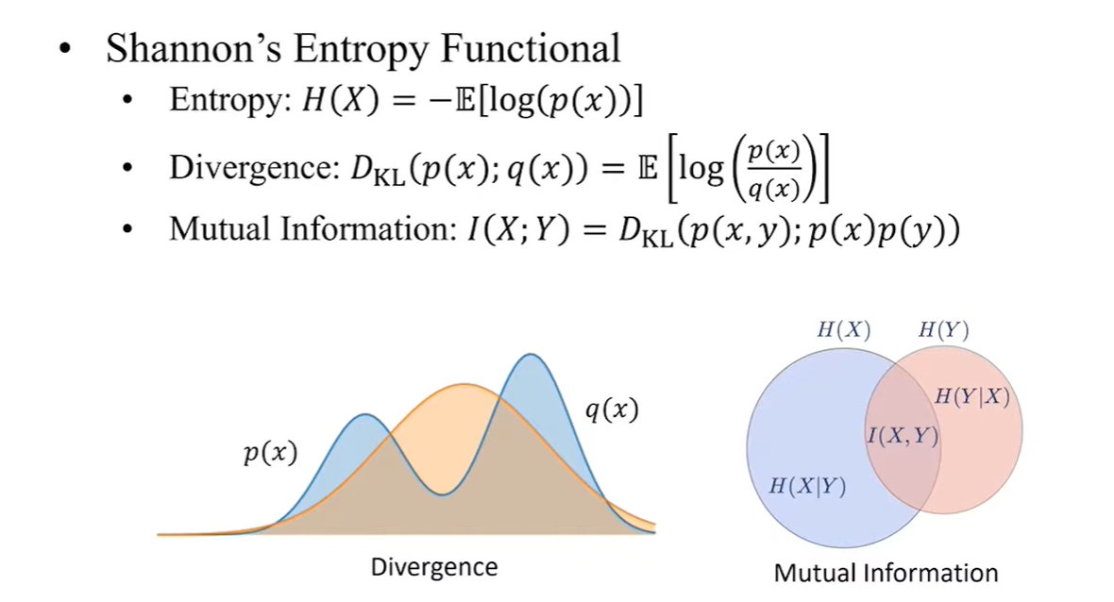
Details of Generating the Feature Importance

Slide 25
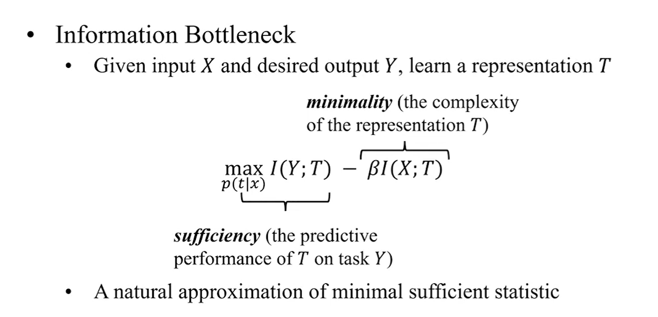
Details of Generating the Feature Importance

Slide 26
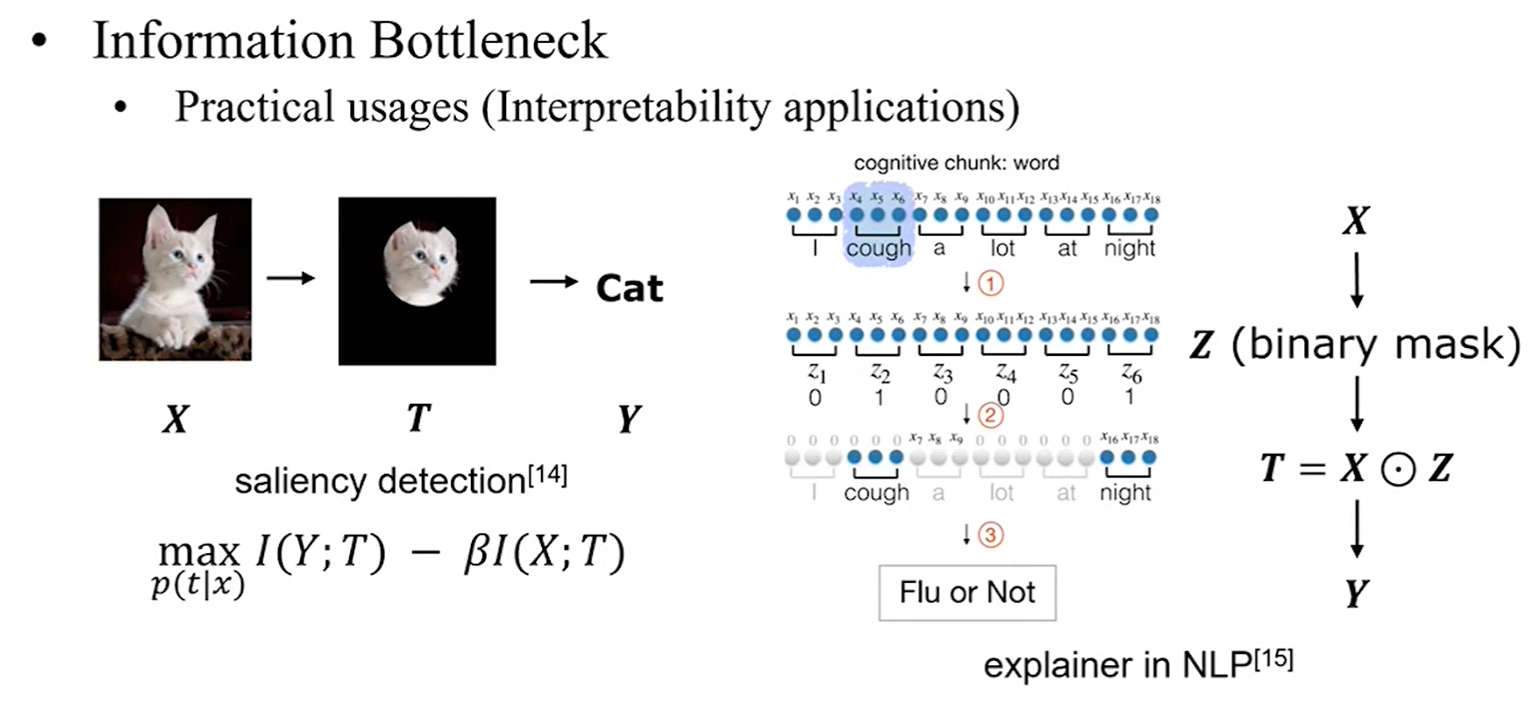
Details of Generating the Feature Importance

Slide 27
Further Reading
Jonathan Crabbé and et.al ,Explaining Latent Representations with a Corpus of Examples, NeurIPS 2021
Jonathan Crabbé and Schaar, Label-Free Explainability for Unsupervised Models, ICML 2022
https://www.vanderschaar-lab.com/interpretable-machine-learning/

Slide 28
Summary
Explainable time series methods based on feature importance has made significant progress, such as perturb-based
SOTA time series models such as transformer-based models or LLM4TS however, has not benefited from it and remain to be black box
Could be combined to increase their accountability and transparency

